Slide 1
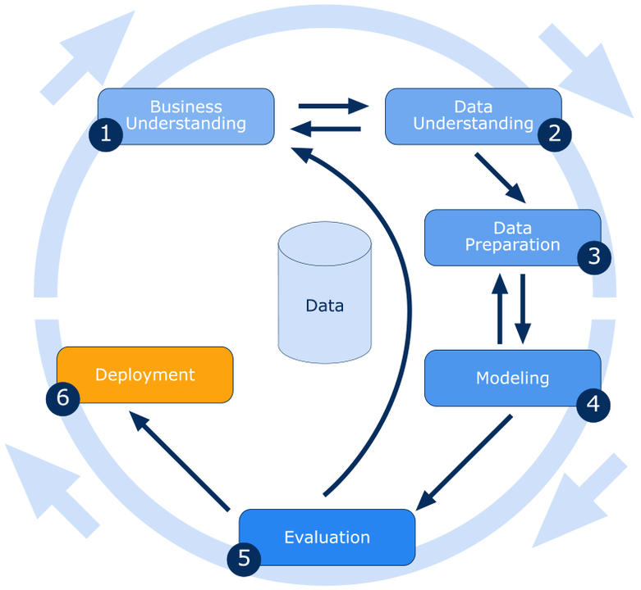
CRISP Methodology
Cross industry standard Process For Data Mining
Predication
Classification
Clustering
ARM
Reinforced Learning
Text processing
Deep learning

Slide 2
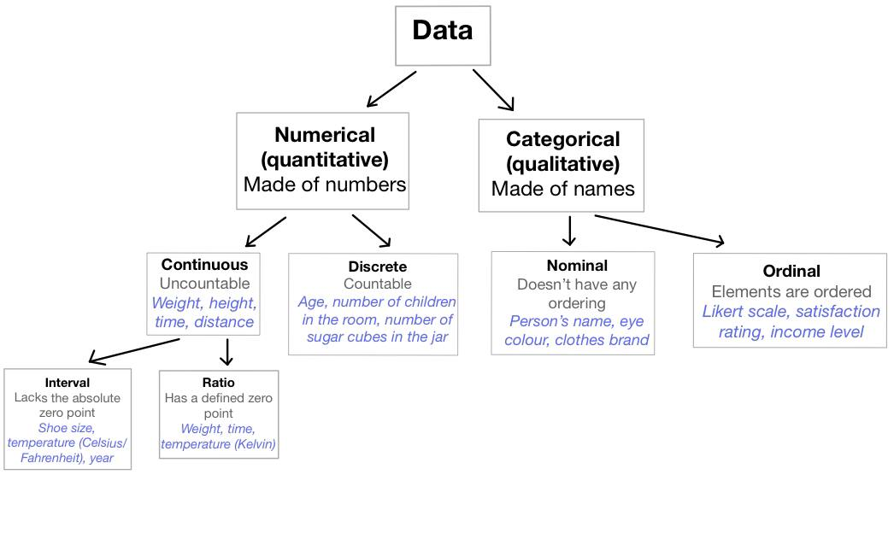

Slide 3
﻿country | label encoder | height | weight | age | gender
af | 0 | 130 | 30 | 10 | m
af | 0 | 125 | 36 | 11 | m
af | 0 | 135 | 34 | 10 | f
af | 0 | 133 | 30 | 9 | f
af | 0 | 129 | 38 | 12 | m
af | 0 | 180 | 90 | 30 | m
af | 0 | 190 | 80 | 25 | m
af | 0 | 175 | 90 | 35 | m
af | 0 | 177 | 60 | 22 | f
usa | 1 | 185 | 105 | 33 | m
usa | 1 | 165 | 55 | 27 | f
usa | 1 | 155 | 50 | 44 | f
usa | 1 | 160 | 58 | 39 | f
usa | 1 | 162 | 59 | 41 | f
usa | 1 | 167 | 62 | 55 | f
uk | 2 | 174 | 70 | 47 | m
uk | 2 | 193 | 90 | 23 | m
uk | 2 | 187 | 80 | 27 | m
uk | 2 | 183 | 88 | 28 | m
uk | 2 | 159 | 40 | 29 | f
uk | 2 | 164 | 66 | 32 | f
uk | 2 | 166 | 56 | 42 | f

Slide 4
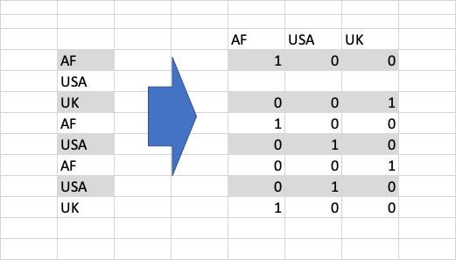

Slide 5
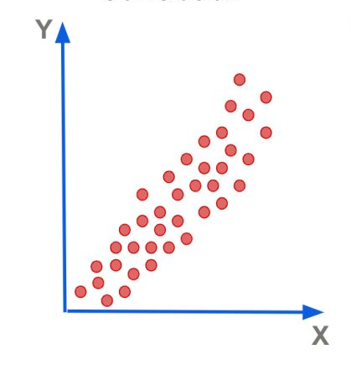
Y=ax+b

Slide 6
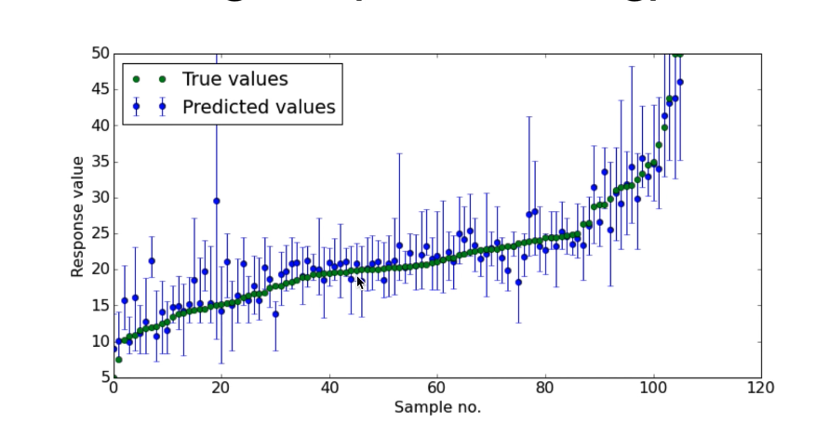
Predication and Forecasting

Slide 7
Linear Regression
(X) Independent Varialbe
(Y) Dependenat Variable
y= ax+b
(a) coefficient

Slide 8
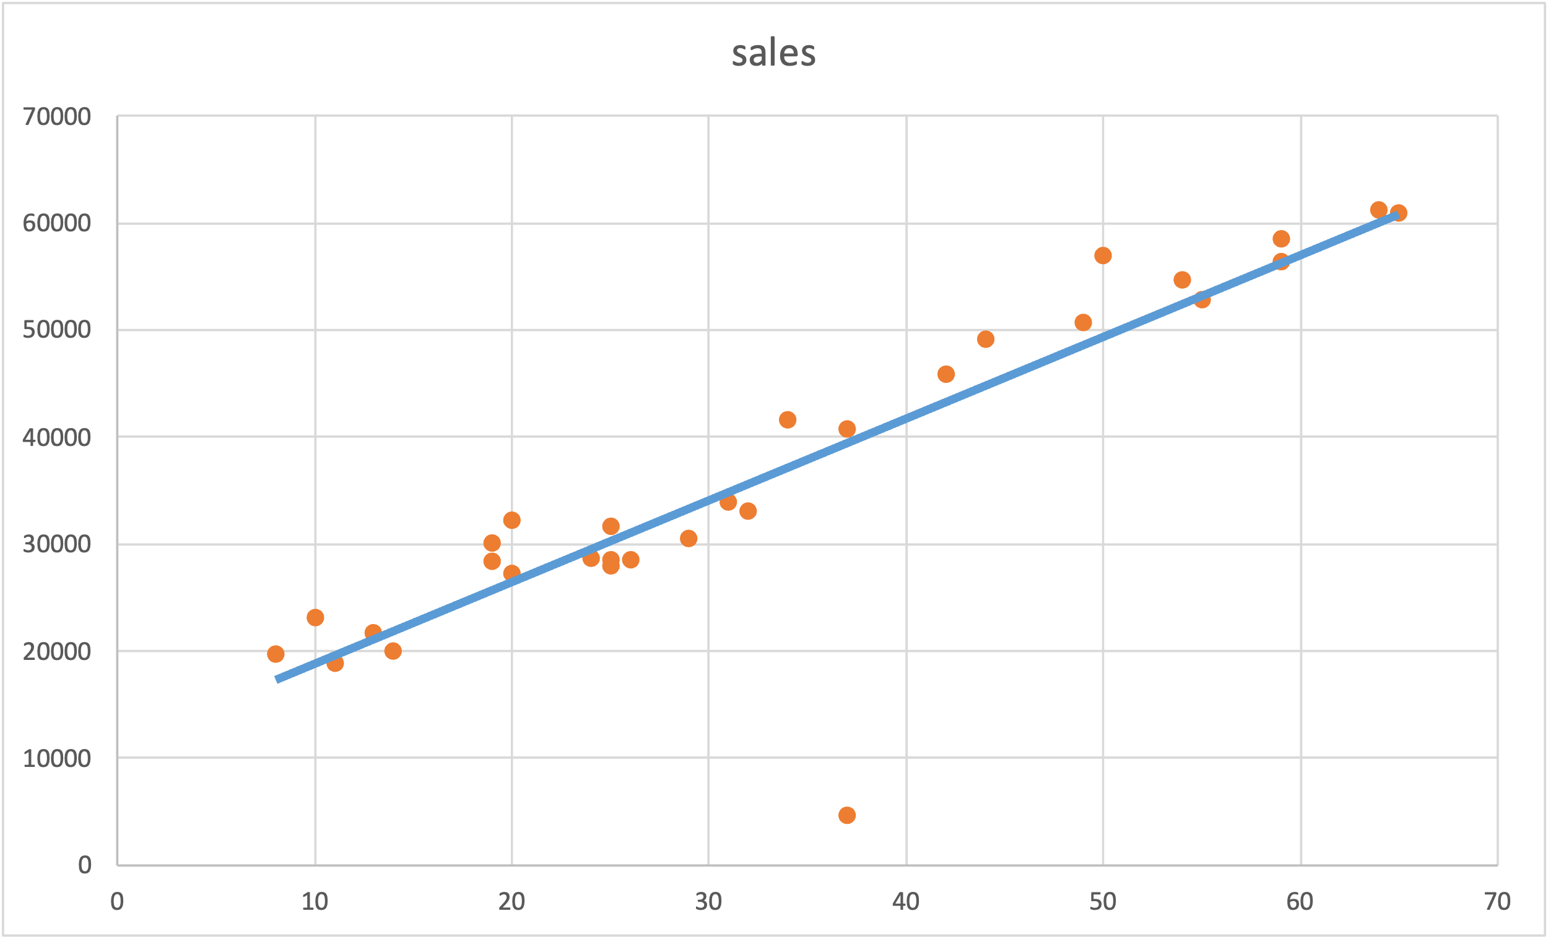
Y=ax+b

Slide 9
